Slide 1

plasma donor application
C.Shanmuga Priya
C.Akila
D.Blessy Jeffrin
Y.Sorna Irin

Slide 2
Problem statement
During COVID 19 crisis the requirement for plasma increased drastically.
No vaccination found in order to treat the infected patients.
Saving the donor information and notifying about the current donors.
It can save time and help the users to track down the necessary information about the donors.

Slide 3
Proposed solution
This system proposed here aims at connecting the donars & the patients by an online application.
Sharing nearby ambulance services.
We can save life who are in need of plasma.

Slide 4
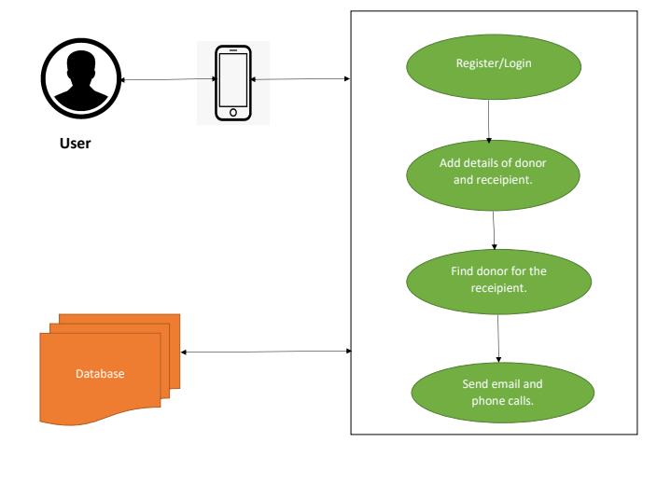
Solition architecture

Slide 5
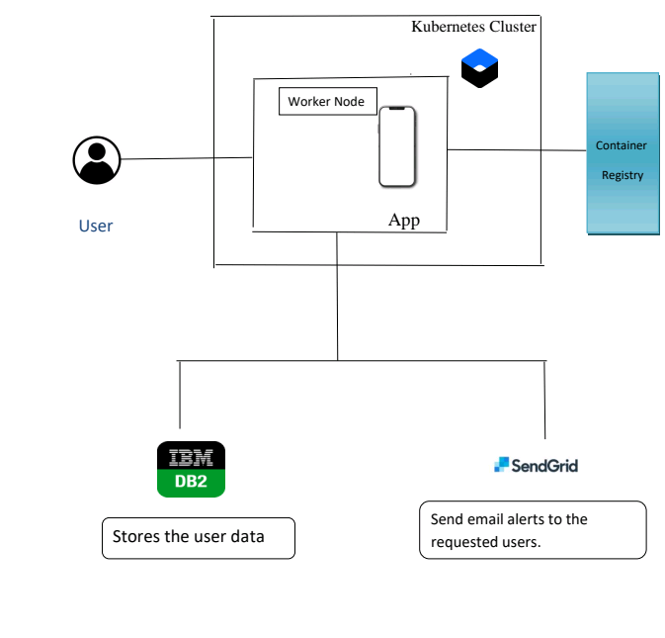
Technical architecture

Slide 6
Functional requirements
User Registration
Registration through Form
Registration through Gmail
User Confirmation
Confirmation via Email
Confirmation via OTP
Data Entry
Collect the data from the user
Fill the information

Slide 7
Analysing data
Analysing data and giving result based on their request.
Technology Used
Flask
IBM DB2
Docker
Kubernets
IBM Cloud
Phases
Request phase
Response phase

Slide 8
Video demo
https://youtu.be/FTSa-8lIdBY

Slide 9
Future scope
User interface (UI) can be improved in future to accommodate global audience by supporting different languages across countries.
Data scraping can be done from different social networks and can be shown in the PlasmaRequest Feeds.
Appointments can be synchronized with Google and Outlook calendars for the ease of users.

